Slide 1

Seven Steps to A Better French Horn Section
By Dr. Lauren Hunt
French horn chair and Director of Brass Studies
Interlochen Center for the Arts

Slide 2

About Me
Download presentation materials at http://www.laurenhunthorn.com/7
Linda VanSickle Smith French Horn Chair and Director of Brass Studies at Interlochen Center for the Arts, 2023-present
Assistant Professor of Horn at USU, 2019-2023
Freelancer in Washington DC, 2018-2019
Instructional Assistant Professor of Horn at Illinois State University, January 2016 – May 2018
Degrees from New England Conservatory (BM), Yale School of Music (MM), and University of Georgia (DMA)

Slide 3
Inspirations for this presentation
http://www.laurenhunthorn.com/7

Slide 4
Seven topics to cover today
Mouthpiece position
Posture and playing position
Tone
Warming up
Correct use of the double horn
Register and range
Dental problems
I always refer to written / horn pitch, NOT concert pitch.

Slide 5
Seven topics to cover today
Mouthpiece position
Posture and playing position
Tone
Warming up
Correct use of the double horn
Register and range
Dental problems

Slide 6
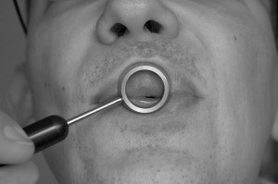
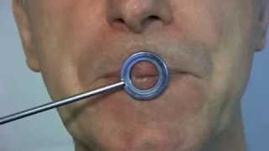
Mouthpiece Positioning
CORRECT for horn
Incorrect for horn (correct for trumpet)

Slide 7
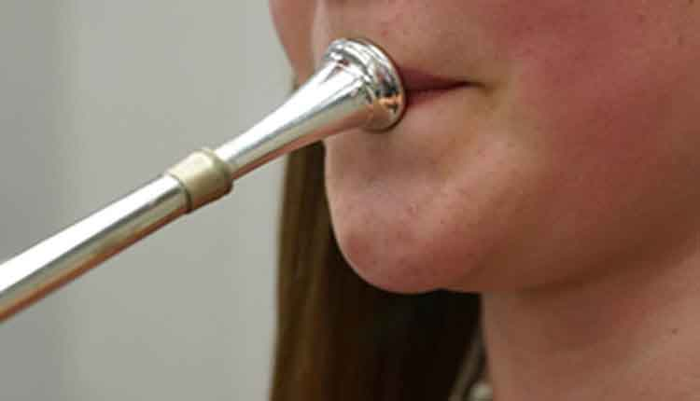
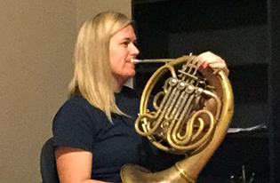
Lower Lip as primary support
Correct angle
Incorrect angle

Slide 8
Seven topics to cover today
Mouthpiece position
Posture and playing position
Tone
Warming up
Correct use of the double horn
Register and range
Dental problems

Slide 9
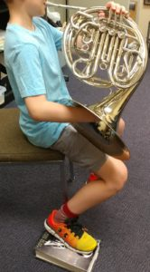
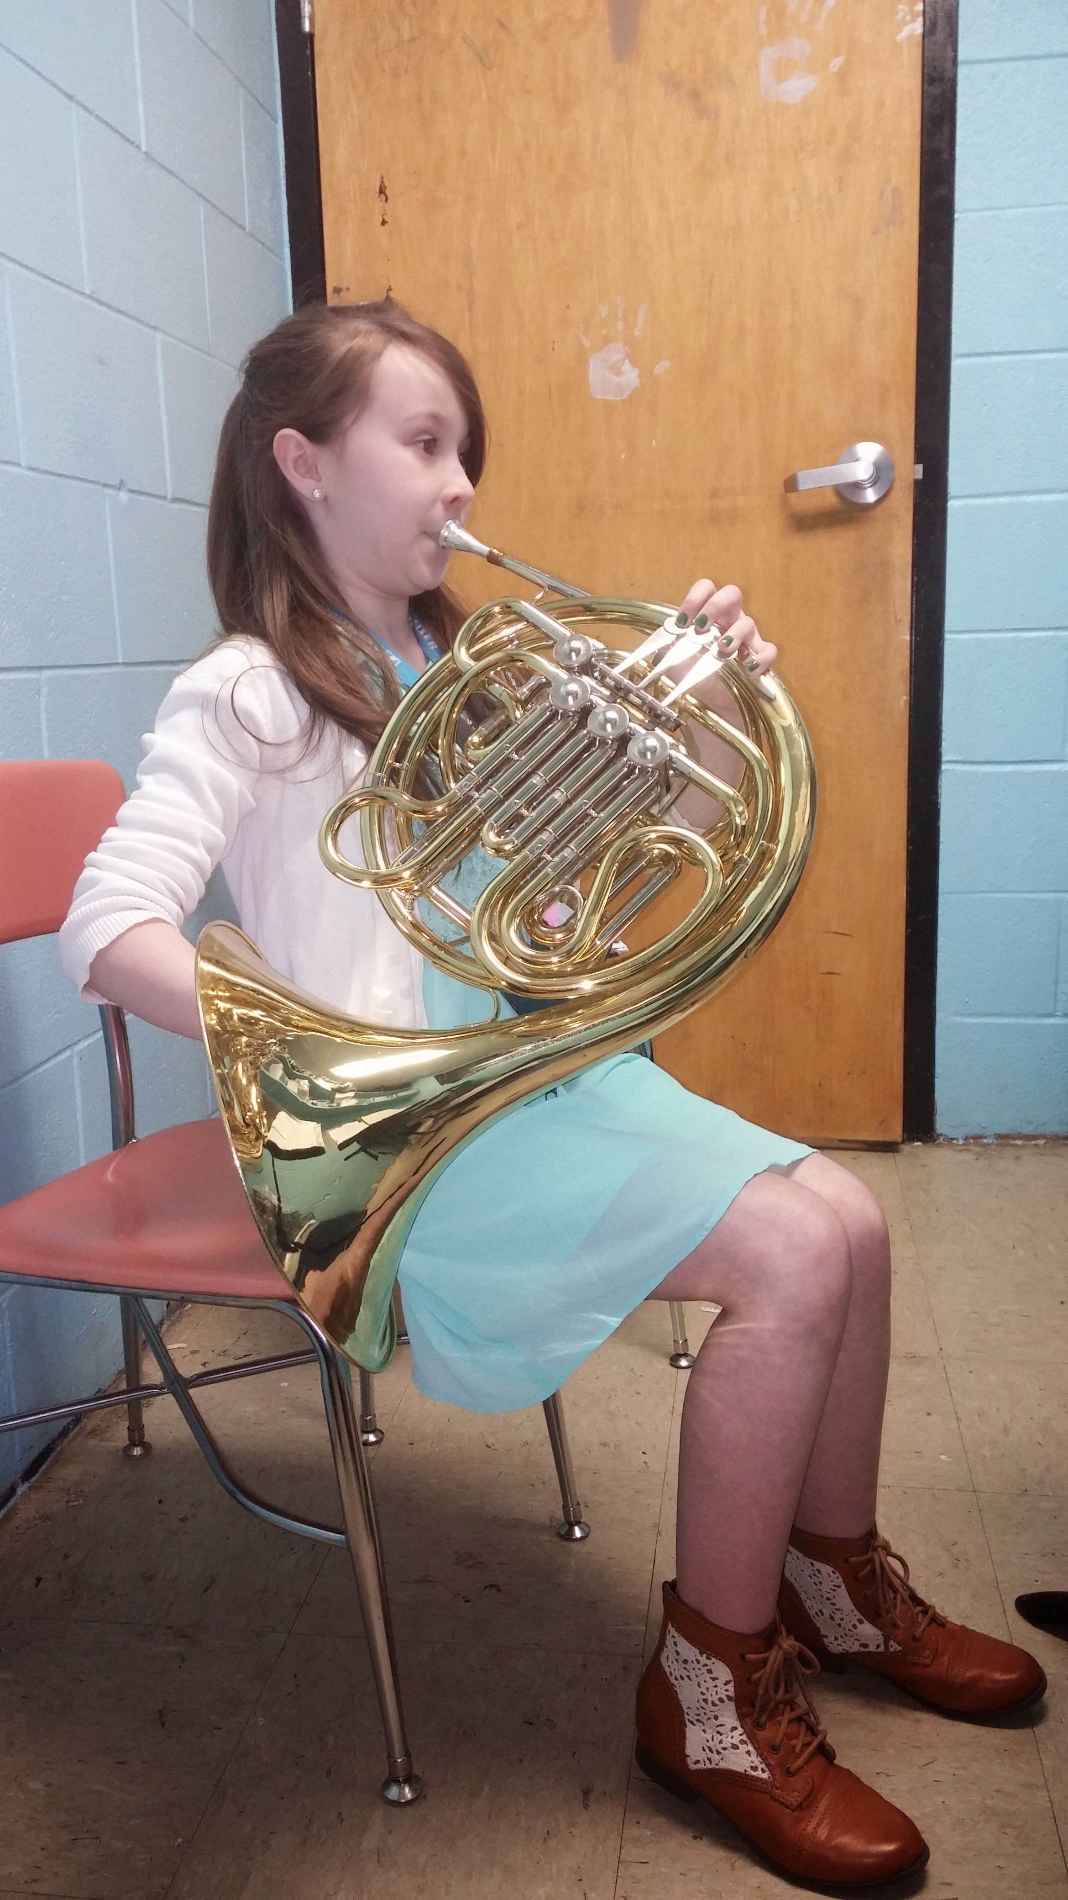
Posture for Young
Beginners
Sit or stand naturally,
with good posture
Bring instrument to the face
Correct angle of mouthpiece / leadpipe

Slide 10
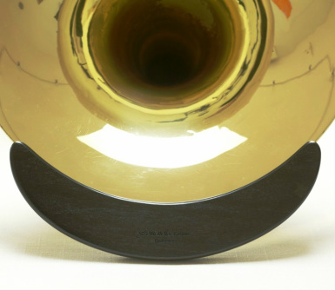
“off the Leg”
Recommended for older students, even beginners
Standard for most professionals
Avoids posture issues of on-the-leg playing
Bell rest device can help posture problems if unable to hold up horn

Slide 11
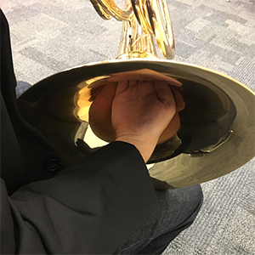
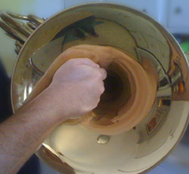
Right Hand position: young beginners

Slide 12
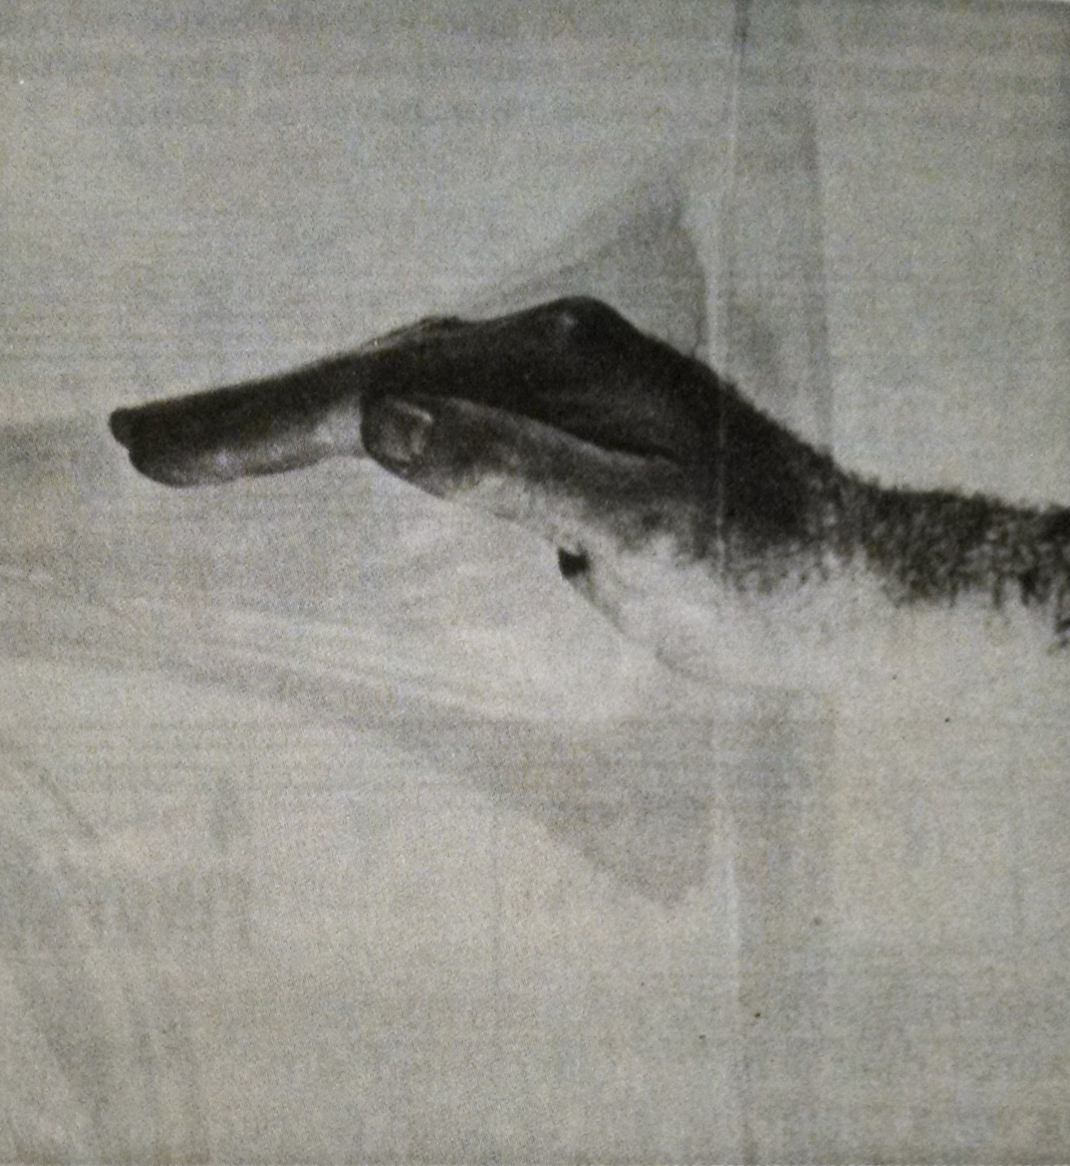
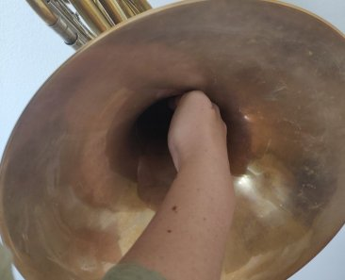
Right Hand position:
Other players

Slide 13
Seven topics to cover today
Mouthpiece position
Posture and playing position
Tone
Warming up
Correct use of the double horn
Register and range
Dental problems

Slide 14
Tone
Separate beginning horns from trumpets, if possible
Help student hear better tone inside head
  Demonstrate for students
  Private teachers
  Listen to recordings
  “Judgement-free” experimentation
Correct horn fingerings
Correct right hand position
Improving resonance
  Use air well, like on other brass instruments
  Keep tongue very low in mouth

Slide 15
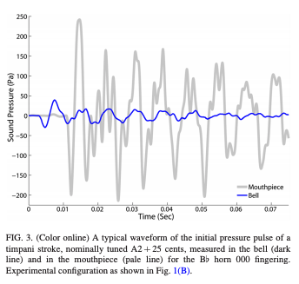
Optimizing band set-up
Interference between horn and percussion impacts accuracy
  http://dx.doi.org/10.1121/1.4829533
Avoid bells pointing into fabric (other students or curtains)
Reflective surfaces (shell or sound shields) should be 4-12 feet away from bells
Bells pointed at audience help volume but lose characteristic horn sound

Slide 16
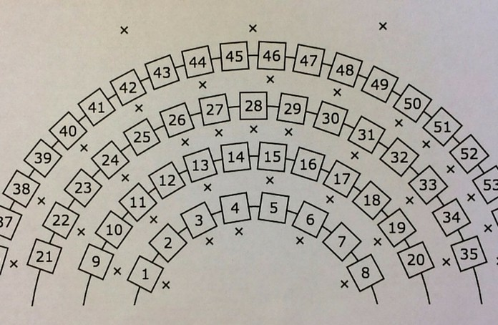

Image source: https://banddirectorstalkshop.com/wp-content/uploads/2015/12/Seating-e1451278139697.jpg

Slide 17
Seven topics to cover today
Mouthpiece position
Posture and playing position
Tone
Warming up
Correct use of the double horn
Register and range
Dental problems

Slide 18
Warm up ranges
Horn in F vs. most other instruments in B-flat or C
In band warm-ups, horn 5th lower or 4th higher than the range they actually should warm up on
If playing higher octave, stresses embouchure muscles before warming up
If playing lower octave, warms up more effectively, but then sudden shift to high register in repertoire

Slide 19
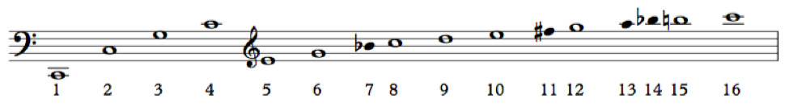
Overtone Exercises
Horn higher on the overtone series than other brass = notes closer together
To match other brass in overtone studies, must skip partials
Leads to issues with air use and accuracy
Horn players should play all partials when doing overtone exercises
Recommended text: Progressive Studies in Flexibility and Range Development for French Horn by Fred W. Teuber (Medici Music Press)

Slide 20
Scales are not an effective warm-up for most brass players

Slide 21
Helping students Understand Horn Vs. Concert Pitch

Slide 22
Seven topics to cover today
Mouthpiece position
Posture and playing position
Tone
Warming up
Correct use of the double horn
Register and range
Dentalproblems

Slide 23
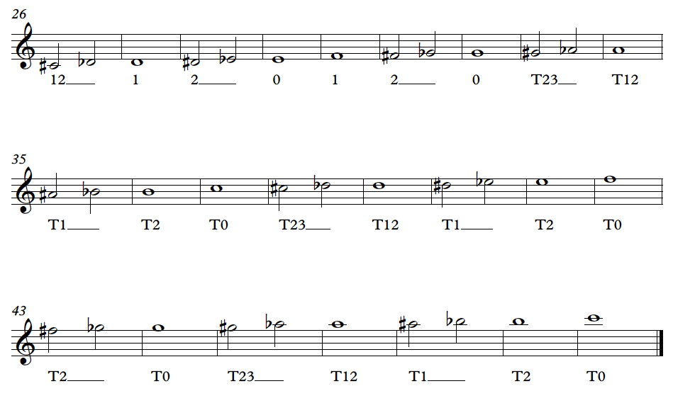
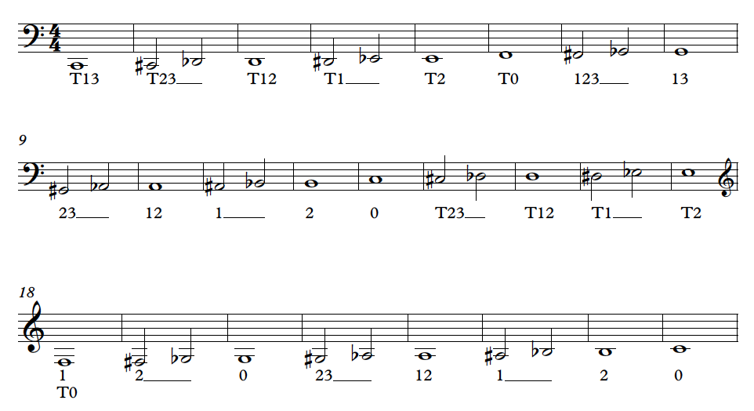
Standard Double Horn Fingerings

Slide 24
Why use Standard Double Horn Fingerings?
Optimal horn tone quality
Intonation
Accuracy
Teaching only B-flat side fingerings may be easier in a combined class with beginning trumpet, but will sacrifice tone and intonation
Force students to relearn fingerings when moving from single to double horn

Slide 25
Seven topics to cover today
Mouthpiece position
Posture and playing position
Tone
Warming up
Correct use of the double horn
Register and range
Dental problems

Slide 26
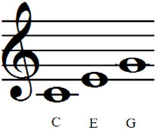
First notes for beginners
(All written pitches)
Most band books start horn around F
  Too high or too low
  Relies on fingering rather than pitch recognition / embouchure
Start horn players separately from other brass if possible
Check individual pieces for appropriate range

Slide 27
Seven topics to cover today
Mouthpiece position
Posture and playing position
Tone
Warming up
Correct use of the double horn
Register and range
Dental problems

Slide 28
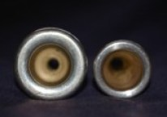
Dental Issues
Most problematic for students who use excessive mouthpiece pressure
Air-driven sound solves many braces-related issues
Air especially important in developing high register
Neill Sanders mouthpiece rim (available through Osmun Music, $100)
Encourage students to remove wisdom teeth before college

Slide 29
Thank you!
Dr. Lauren Hunt
French Horn Chair and
Director of Brass Studies
Interlochen Center for the Arts
Lauren.hunt@interlochen.org
http://www.laurenhunthorn.com/7

